Slide 1
Chapter 4
Ethics & Safety in Generative AI

Slide 2
Generative AI ethics: What to know
Generative AI refers to the subset of artificial intelligence tools that an individual or business can use to generate content or information.
While other types of AI might focus on analyzing or interpreting data, generative AI functions to produce new outputs that, in some cases, might resemble the original content or information used to train the GenAI model.
Generative AI's ability to quickly generate new textual, visual, and auditory content offers a wide range of benefits and risks.
For example, AI-generated text, images, and videos make it possible to spread misinformation at scale, given that it’s becoming more difficult to tell human-generated content from AI-generated content.
Clear ethical guidelines around AI-generated content could help reduce the spread of misinformation.

Slide 3
What are some ethical considerations of using Generative AI?
In general, using GenAI ethically means designing, managing, and using these tools responsibly while avoiding harming others.
The ethical use of generative AI has several components that you’ll need to consider, whether you’re a developer designing or improving AI tools, a business leader integrating GenAI into business practices, or an individual user looking to increase productivity.
The following components can apply to many different generative AI use cases:
Professional and creative integrity
Respecting intellectual property
Data privacy
Transparency
Eliminating bias
Third-party fact-checking
Empowering and reskilling the workforce

Slide 4
1. Professional and creative integrity
When using GenAI for academic, professional, or creative purposes, it’s essential to acknowledge how you use AI to produce work.
Doing so can help ‌establish trust and credibility in your field.
2. Respecting intellectual property
When using GenAI tools, be sure to comply with copyright laws and avoid plagiarizing the original work of others.
In addition, avoid inputting copyrighted material to GenAI tools to generate outputs.
If you do reference work by others, be sure to provide the proper attributions.

Slide 5
3. Data privacy
GenAI tools are trained on large and diverse data sets. In addition, they can process a lot of data in a short period of time.
While these capabilities make GenAI a powerful tool for generating useful outputs, it’s essential to protect the privacy of individuals whose data might be involved in GenAI training.
4. Transparency
Transparency in the world of GenAI works alongside data privacy, professional and creative integrity, and respecting intellectual property.
You should communicate openly with stakeholders, users, or collaborators regarding how AI-generated content is produced, the sources of data, and how a GenAI tool works.
Transparency can also refer to communication across industries and sectors to share best practices and collaborate on creating ethical AI guidelines.

Slide 6
5. Eliminating bias
When using GenAI to create content, it’s important to mitigate potential bias in the outputs. Bias in GenAI outputs can occur when the data a model is trained on is incomplete, limited, or skewed.
Biased outputs might represent the experiences and views of only a narrow demographic or contain content that some demographics might find offensive.
You can mitigate bias by training a model with comprehensive data from diverse sources, adopting a system to retrain models iteratively, and once again being transparent about the sources on which models are trained.
6. Third-party fact-checking
Third-party fact-checking refers to the process of verifying the accuracy and credibility of AI-generated content. While GenAI can often produce elegant outputs that closely resemble human communication, the outputs may not always be based on factual information. It’s up to users to consult reputable sources of information or subject-matter experts when evaluating the quality and accuracy of a GenAI output.

Slide 7
7. Empowering and reskilling the workforce
Given that GenAI tools can automate many work-related tasks, there are some jobs that might become out of date as companies adopt GenAI. This presents an ethical concern, as members of the workforce face unemployment or job displacement. Company leaders can, instead, work to empower and reskill employees whose jobs are affected by AI or even support employees in transitioning to a new role or industry.

Slide 8
Generative AI risks
Using GenAI ethically can spark creativity and innovation. However, it comes with inherent risks that you’ll need to understand. Understanding these can strengthen your commitment to ethical AI use and make it easier to develop a comprehensive risk management plan.
Some of the most common GenAI risks include (but aren’t limited to):
Hallucinations: Incorrect or misleading AI outputs that result from limited or biased data that the model was trained on. Using hallucinatory outputs without fact-checking them could lead to unintended consequences if people take action based on the inaccuracies they encounter.
Deepfakes: Audio, images, or video that appear to be real but have been manipulated by AI. Deepfakes can be used maliciously, such as to impersonate politicians and sway elections.
Job displacement: Automation and efficiency of GenAI may make some job roles or industries obsolete, thus affecting members of the workforce and the economy at large.

Slide 9
How to use GenAI ethically in your business
Knowing the ethics, benefits, and risks of generative AI is crucial for businesses to harness its full potential. Here’s how you can establish responsible practices in your business:
1. Identify what you’re using it for.
Start the GenAI implementation process by defining which AI tools your business will use and how it will use them. Uses might include creating content, developing products, or automating customer service. Knowing your business’s use cases will help ‌align them with ethical considerations.
2. Set quality standards.
Define the criteria for evaluating the quality of GenAI outputs. Criteria could include accuracy, diversity and inclusion, adherence to a particular style or brand voice, and fairness. Schedule time to monitor outputs and retrain AI tools to improve their performance.
3. Keep humans at the center of GenAI.
Emphasize the importance of augmenting rather than replacing human capabilities with GenAI. Make sure humans make the decisions for every initiative, including AI-powered content or data.
If you’re a leader within your organization, you might consider appointing an AI ethics specialist to help guide how the organization uses GenAI and to provide oversight on AI’s ethical use.

Slide 10
4. Create organization-wide AI policies.
Develop comprehensive GenAI policies and guidelines that cover all functions and departments within your organization. The policies should address ethical considerations, data privacy, transparency, compliance, how to mitigate bias and other risks, and professional integrity.
5. Create a public-facing statement on GenAI use.
Communicate your organization’s commitment to the ethical use of generative AI through a public-facing document. This document should express your organization’s AI principles, values, and practices and reassure customers, stakeholders, and the general public of your organization’s AI ethics.
6. Review GenAI policies regularly.
Regularly review and update your organization’s policies on GenAI use to make sure they reflect the latest ethical standards, regulatory requirements, and technological advancements.

Slide 11
Text Representation
It represents input text data into a predictable and analyzable form.
There are different ways to represent text
Tokenization
Stemming
Stop words
N-gram Modelling

Slide 12
Tokenization
Tokenization can separate sentences, words, characters, or subwords.
Importance of Punctuation in Tokenization
Punctuation provides valuable information for NLP applications
Examples: commas, periods, hyphens
Punctuation can indicate sentence boundaries and separate entities
Example: "Mr. Smith went to the store."

Slide 13
Handling Punctuation
In many cases, punctuation should be treated as separate tokens
Examples: m.p.h., Ph.D., cap’n
Keeping punctuation within words preserves their meaning
Example: "m.p.h." should not be tokenized as "m", ".", "p", "h"
Special Characters and Numbers
Special characters and numbers play crucial roles in text
Examples: prices ($45.55), dates (01/02/06)
Special characters and numbers should be preserved as single tokens
Example: "$45.55" should not be tokenized as "$", "45", ".", "55"

Slide 14
Handling URLs and Email Addresses
URLs, hashtags, and email addresses are common in text data
Examples: https://www.stanford.edu, #nlproc, someone@cs.colorado.edu
Treating URLs and email addresses as single tokens maintains their integrity
Example: "https://www.stanford.edu" should not be tokenized as separate words or characters
Tokenization Challenges
Tokenizing numbers requires language-specific considerations
Differentiating between punctuation commas and digit grouping commas
Ensuring accurate representation of numbers in tokenized form

Slide 15
Adaptation in Tokenization
Tokenization algorithms need to adapt based on the language and context
Incorporating language-specific rules for number tokenization
Ensuring consistency and accuracy in tokenization across languages
Proper tokenization is essential for effective natural language processing
Preserving punctuation, special characters, and numbers maintains the semantic meaning of text
Understanding the context of tokenization improves NLP tasks such as parsing, sentiment analysis, and machine translation

Slide 16
Penn Treebank Tokenization Standard
Commonly used in parsed corpora (treebanks) released by the Linguistic Data Consortium (LDC)
Features of Penn Treebank Tokenization
Separation of clitics
Preservation of hyphenated words
Separation of punctuation
Example input and output
Example Input and Output
Input: "The San Francisco-based restaurant," they said, "doesn’t charge $10".
Output: “_The_San_Francisco-based_restaurant_ ,_ “_ they_ said_ ,_ _“_ does_ n’t_charge_$_ 10 _“_ .

Slide 17
Separation of Clitics
Clitics such as "doesn’t" are split into separate tokens
Example: "does" + "n’t"
Preservation of Hyphenated Words
Hyphenated words are kept together as single tokens
Example: "San Francisco-based"
Separation of Punctuation
All punctuation marks are separated into individual tokens
Example: "," ".", "$"

Slide 18
Byte-Pair Encoding for Tokenization
Introducing automatic tokenization as an alternative approach to defining tokens in text data
Addressing the challenge of unknown words in language processing
Introducing subword tokenization as a solution to handle unknown words
Subword Tokenization
Definition: Subword tokenization involves inducing sets of tokens smaller than words
Subwords can be arbitrary substrings or meaning-bearing units like morphemes
Example: -est or -er are morphemes in words like "unlikeliest" and "happier"

Slide 19
Morphemes are the smallest meaning-bearing units of a language
Example: "un-", "likely", and "-est" are morphemes in the word "unlikeliest"
Modern Tokenization Schemes
Most tokens are words, but some are frequently occurring morphemes or subwords
Subword units help represent unseen words by composing them from known subword units
Example: "lower" can be represented as "low" and "er"

Slide 20
Advantages of Subword Tokenization
Handles unknown words effectively by breaking them down into meaningful units
Improves coverage and adaptability across different vocabularies and languages
Enhances the flexibility and robustness of tokenization algorithms
Program:

Slide 21
Stemming
Stemming is one method of text representation in which we mainly just strip suffixes from the end of the word.
Porter stemmer is a widely used stemming algorithm
This was not the map we found in Billy Bones’s chest, but an accurate copy, complete in all things-names and heights and soundings-with the single exception of the red crosses and the written notes.
Thi wa not the map we found in Billi Bone s chest but an accur copi complet in all thing name and height and sound with the singl except of the red cross and the written note

Slide 22
The algorithm is based on series of rewrite rules run in series: the output of each pass is fed as input to the next pass.
ATIONAL → ATE (e.g., relational → relate)
ING → if the stem contains a vowel (e.g., motoring → motor)
SSES → SS (e.g., grasses → grass)
Errors of Commission and Omission
Stemmers may commit errors of over-generalization (commission) and under-generalization (omission)

Slide 23
Errors of Commission
Stemmers over-generalize by incorrectly reducing words to a common stem
Example: organization -> organ, doing -> doe
Errors of Omission
Stemmers under-generalize by failing to reduce words to their common stem
Example: analyzes -> analysis

Slide 24
Impact on Language Processing
Errors of commission can lead to incorrect interpretations or mismatches in information retrieval
Errors of omission may result in missed opportunities for capturing semantic similarities
Challenges in Stemming
Balancing between over-stemming and under-stemming errors
Handling irregular word forms, irregular plurals, and exceptions to linguistic rules

Slide 25
Mitigating Errors in Stemming
Employing more sophisticated stemming algorithms that consider linguistic rules and context
Integrating stemming with other text processing techniques such as lemmatization and part-of-speech tagging
Conducting thorough evaluation and validation of stemming results in specific application contexts
Program

Slide 26
Stop words
stopwords are frequently filtered out to enhance text analysis and computational efficiency.
Eliminating stopwords can improve the accuracy and relevance of NLP tasks by drawing attention to the more important words, or content words.

Slide 27
Common Stopwords: These are the most frequently occurring words in a language and are often removed during text preprocessing. Examples include “the,” “is,” “in,” “for,” “where,” “when,” “to,” “at,” etc.
Custom Stopwords: Depending on the specific task or domain, additional words may be considered as stopwords. These could be domain-specific terms that don’t contribute much to the overall meaning. For example, in a medical context, words like “patient” or “treatment” might be considered as custom stopwords.
Numerical Stopwords: Numbers and numeric characters may be treated as stopwords in certain cases, especially when the analysis is focused on the meaning of the text rather than specific numerical values.

Slide 28
Single-Character Stopwords: Single characters, such as “a,” “I,” “s,” or “x,” may be considered stopwords, particularly in cases where they don’t convey much meaning on their own.
Contextual Stopwords: Words that are stopwords in one context but meaningful in another may be considered as contextual stopwords. For instance, the word “will” might be a stopword in the context of general language processing but could be important in predicting future events

Slide 29
N-gram Modelling
It is the way of determining the probability of any sequence of words

Slide 30
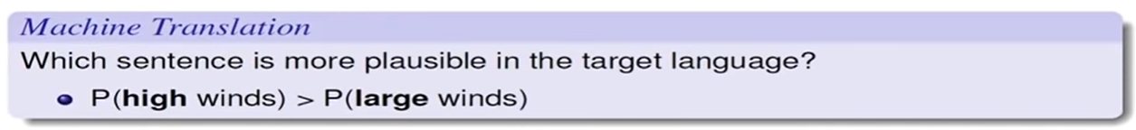
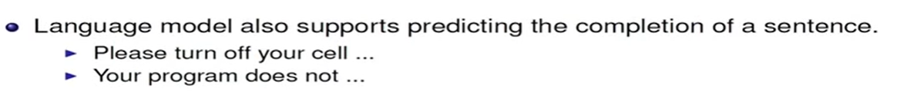

Slide 31
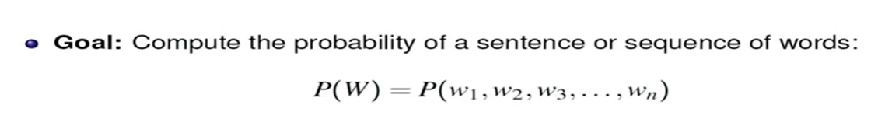


Slide 32
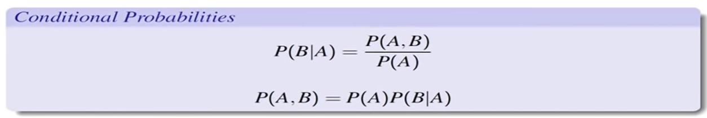
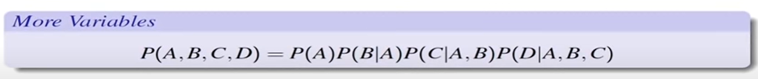

Slide 33

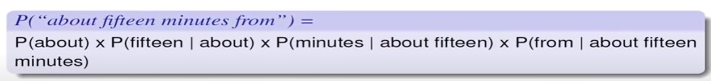

Slide 34
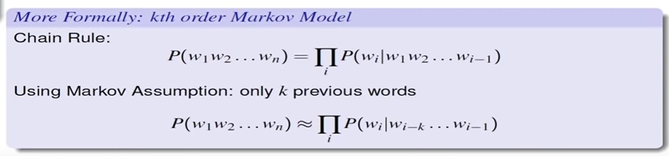

Slide 35
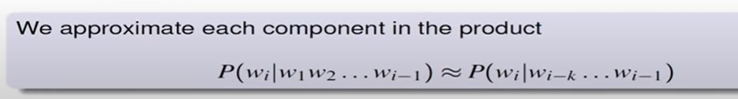
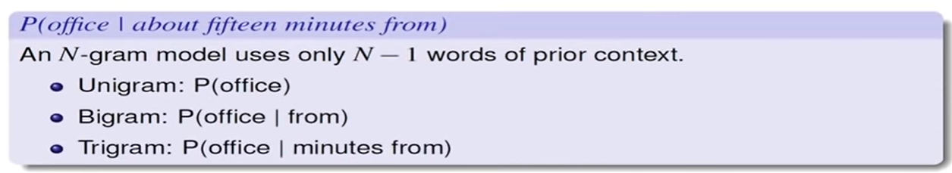

Slide 36
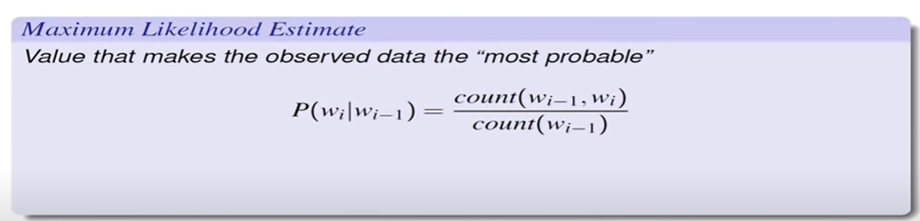
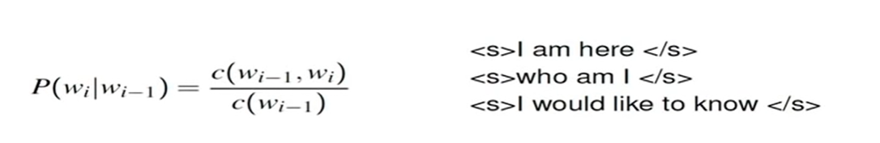
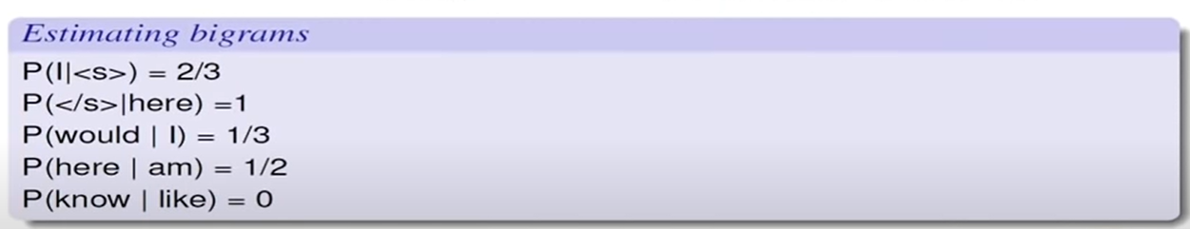
EXAMPLE :

Slide 37
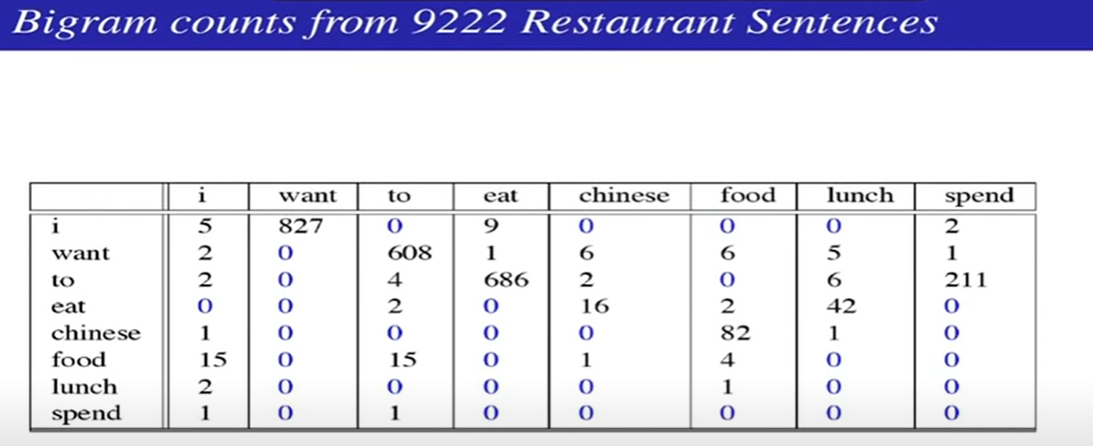

Slide 38
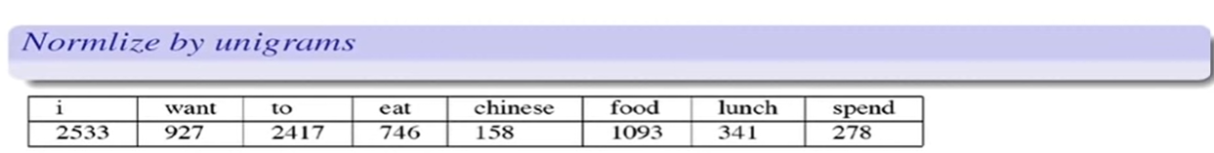
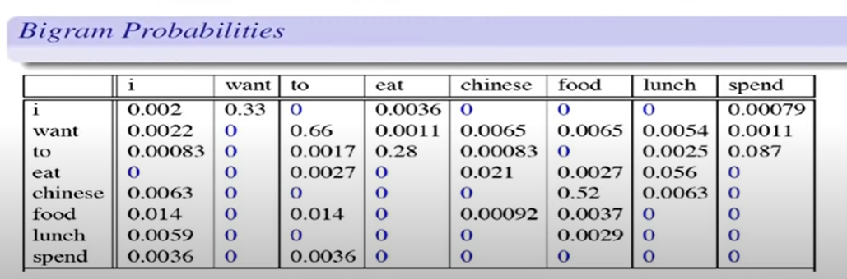

Slide 39
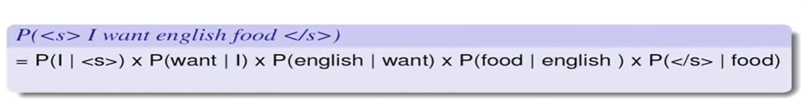
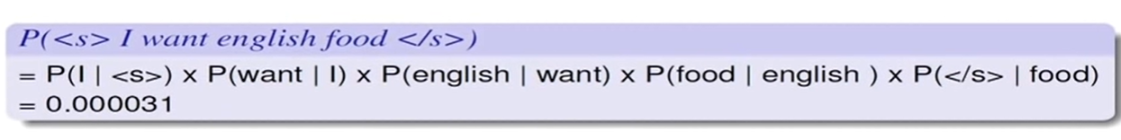
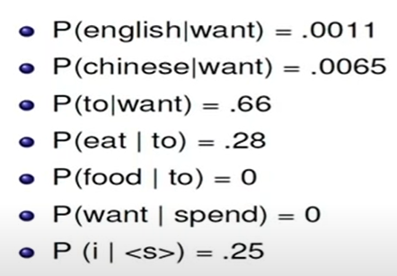

Slide 40
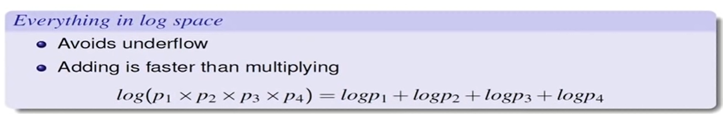

Slide 41

N gram Numerical
Suppose we have a small corpus:
"I love AI" "I love machine learning" "I love deep learning“
Calculate Probability :

Slide 42
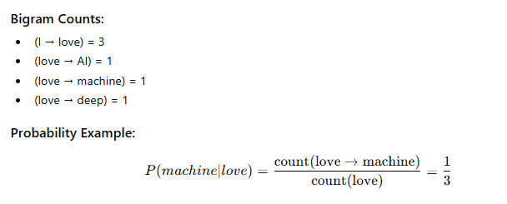

Slide 43
What is a large language model?
A language model is simply a computational system that can predict the next word from previous words. That is, given a context or prefix of words, a language model assigns a probability distribution over the possible next words.
Traditional n-gram models, such as bigram and trigram models, estimate the probability of a word based on a fixed and limited context of one or two preceding words. In contrast, large language models (LLMs) employ advanced architectures that enable them to capture long-range dependencies, allowing word prediction based on contexts extending to thousands or even tens of thousands of tokens.

Slide 44
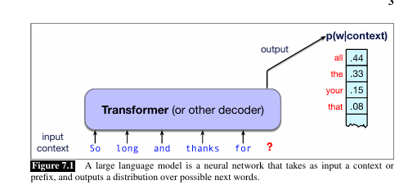
The fundamental intuition of language models is that a model that can predict text (assigning a distribution over following words) can also be used to generate text by sampling from the distribution.

Slide 45
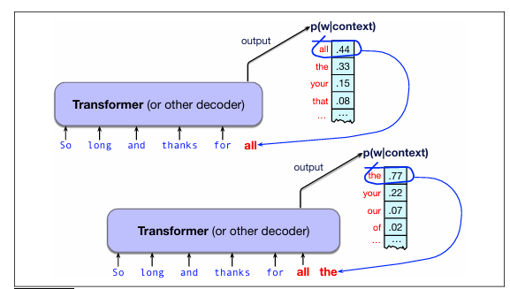

Slide 46
This kind of setting in which we iteratively predict and generate words left-to right from earlier words is often called causal or autoregressive language models.
Three architectures for language models
The three architectures are ,
Encoder
Decoder
encoder-decoder.

Slide 47
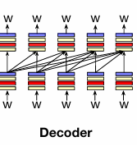
Decoder
The decoder is the architecture we’ve introduced above. It takes as input a series of tokens, and iteratively generates an output token one at a time. The decoder is the architecture used to create large language models like GPT.
The information flow in decoders goes left-to-right, meaning that the model

Slide 48
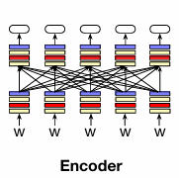
Encoder
Encoder architectures take a sequence of tokens as input and produce contextual embeddings for each token.
These models are typically trained using a masked language modeling objective, wherein selected tokens are masked and the model learns to predict them by leveraging bidirectional contextual information. Representative models include BERT and RoBERT.
Encoder models are not inherently generative; rather, they are widely applied to discriminative tasks such as text classification, where they are fine-tuned on labeled datasets to predict target outputs such as sentiment, topic, or other categories.

Slide 49
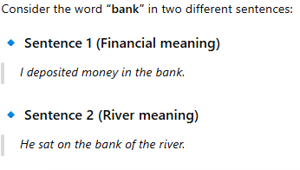
A contextual embedding means that the same word gets different vector representations depending on its context.

Slide 50
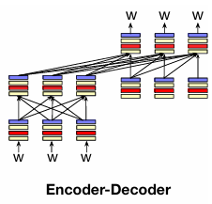
The encoder-decoder takes as input a sequence of tokens and outputs a series of tokens.
What makes it different than the decoder-only models, is that an encoder decoder has a much looser relationship between the input tokens and the output tokens, and they are used to map between different kinds of tokens.
That is, in an encoder-decoder, the output tokens might be from a very different token-set or be a much longer or shorter sequence than the input token sequence.
For example encoder-decoder architectures are used for machine translation, where the input tokens are in one language and the output tokens (probably more or less of them) are in another language.
Encoder-decoder architectures are also used for speech recognition, where the input is tokens representing speech, and the output is tokens representing text.

Slide 51
These three architectures can be built out of many kinds of neural networks. The most widely used network type today is the transformer.
Transformer is a neural network architecture that has fundamentally changed the approach to Artificial Intelligence.
Beyond text, Transformer is also applied in audio generation, image recognition, protein structure prediction, and even game playing, demonstrating its versatility across numerous domains.
The core innovation and power of Transformers lie in their use of self-attention mechanism, which allows them to process entire sequences and capture long-range dependencies more effectively than previous architectures.

Slide 52
Transformer Architecture
Embedding:
Text input is divided into smaller units called tokens, which can be words or subwords. These tokens are converted into numerical vectors called embeddings, which capture the semantic meaning of words.
Let's say you want to generate text using a Transformer model. You add the prompt like this one: “Data visualization empowers users to”. This input needs to be converted into a format that the model can understand and process. That is where embedding comes in: it transforms the text into a numerical representation that the model can work with. To convert a prompt into embedding, we need to
1) tokenize the input,
2) obtain token embeddings,
3) add positional information, and finally
4) add up token and position encodings to get the final embedding. Let’s see how each of these steps is done.

Slide 53
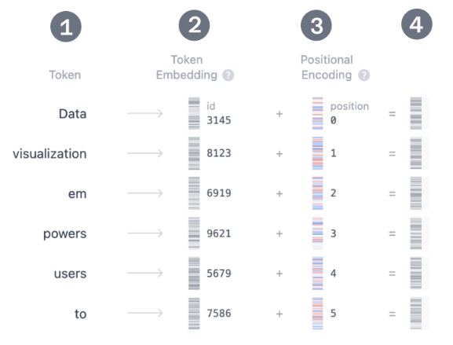

Slide 54
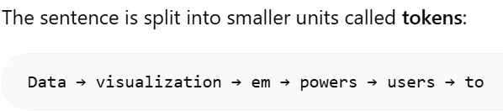
Step 1: Tokenization
Tokenization is the process of breaking down the input text into smaller, more manageable pieces called tokens.
These tokens can be a word or a subword.
The words "Data" and "visualization" correspond to unique tokens, while the word "empowers" is split into two tokens.
The full vocabulary of tokens is decided before training the model: GPT-2's vocabulary has 50,257 unique tokens.
Now that we split our input text into tokens with distinct IDs, we can obtain their vector representation from embeddings.

Slide 55
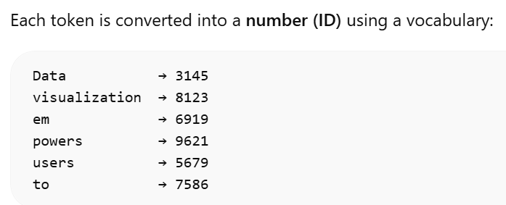

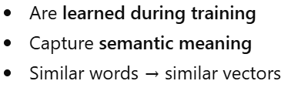
Step 2. Token Embedding
Token → ID Mapping
These numbers have no meaning yet — they are just indices.
Each ID is mapped to a vector

Slide 56
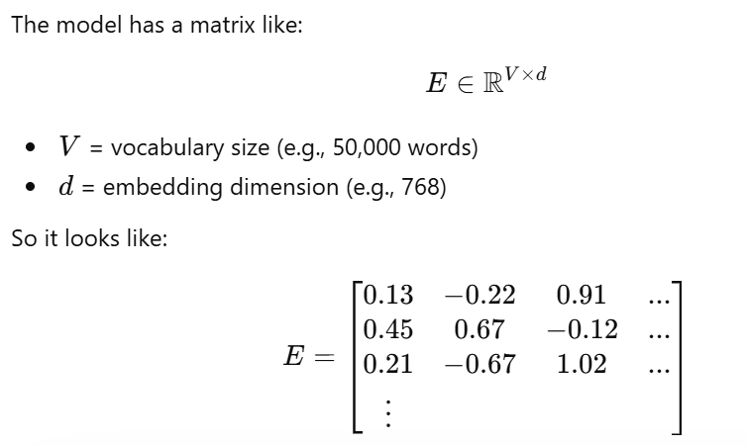
Embedding Matrix - represents a word in a high-dimensional embedding space, where each value corresponds to a learned latent feature contributing to the semantic representation of the word.”
Each row = one word vector

Slide 57
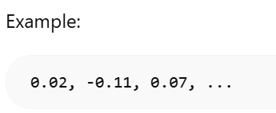
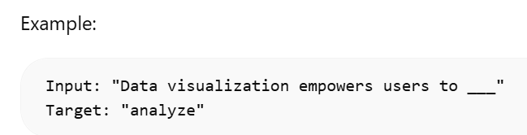
How is this matrix created
Initially: All values are random
Training

Slide 58
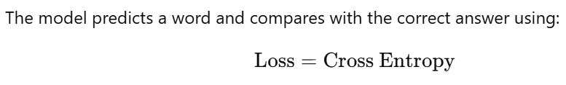
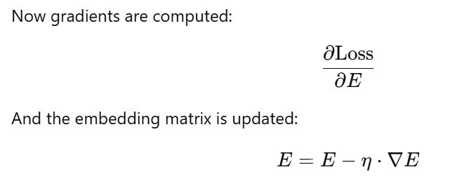
Loss Function

Slide 59
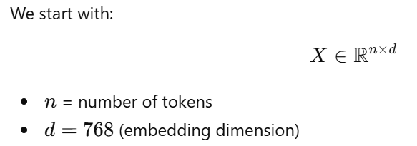
2. Transformer Block
The core of the Transformer's processing lies in the Transformer block, which comprises multi-head self-attention and a Multi-Layer Perceptron layer.
Multi-Head Self-Attention
Input Representation

Slide 60
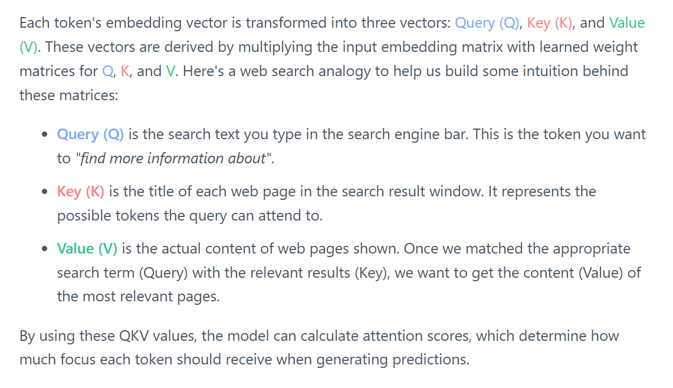
Linear Projections (Creating Q, K, V)

Slide 61
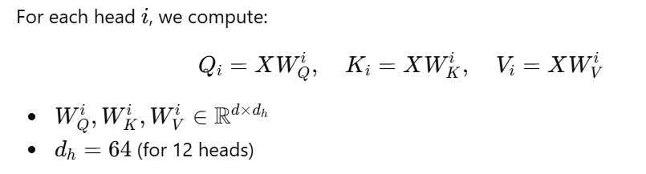
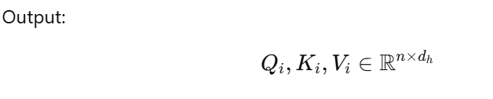
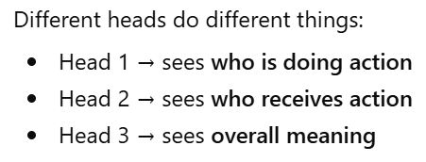

“A head is an individual attention unit in a Transformer that captures a specific type of relationship between tokens.”
Each head looks at the sentence in a different way

Slide 62
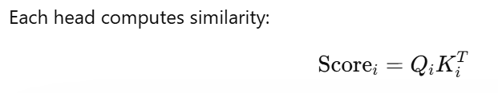
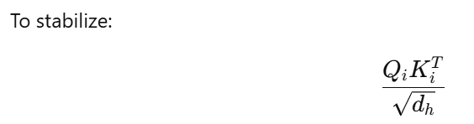
Attention Score Calculation
Each element:
How much one token attends to another
Scaling
Prevents very large values

Slide 63


Softmax (Attention Weights)
Weighted Sum (Final Attention Output)

Slide 64

Concatenation of All Heads
Multi-head self-attention computes attention in parallel across multiple heads, where each head learns distinct relationships between tokens using query, key, and value projections, and the results are concatenated and linearly transformed.”

